Slide 1

New Issue Market(Primary Market)

Slide 2

Meaning of New Issue Market
A new issue is a reference to a security that has been registered, issued, and is being sold on a market to the public for the first time. The issuer may be a new company or an existing company.

Slide 3

Types/Methods of New Issues
Public Issues
Preferential Issues
Rights Issues
Offer for sale
Private Placement
Bonus Issue

Slide 4

Public Issue
When a company raises funds by selling (issuing) its shares (or debenture / bonds) to the public through issue of offer document (prospectus), it is called a public issue.
Initial Public Offering(IPO)
Follow on Public Offering(FPO)
Fast-track Issue(FTI)

Slide 5

Initial Public Offering
When a (unlisted) company makes a public issue for the first time and gets its shares listed on stock exchange, the public issue is called as initial public offer.

Slide 6
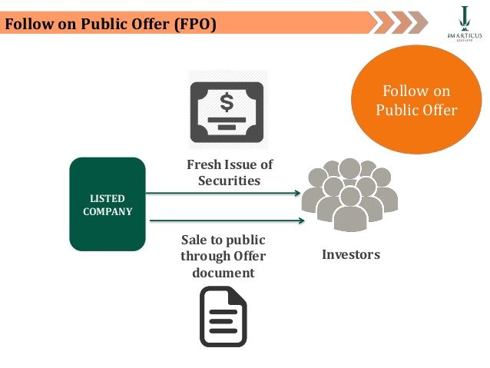
2. Follow-on public offer (FPO)
When a listed company makes another public issue to raise capital, it is called follow-on offer (FPO).

Slide 7

3. Fast Track Issue(FTI)
This facility is available to companies that are listed on the BSE or the NSE for at least three years.

Slide 8

Preferential Issue
The listed companies issue securities to a select group of persons under sec 81 of the companies Act, 1956.
Select group of persons:
Financial Institutions
Mutual Funds or
High net worth individuals

Slide 9

Rights Issue
When a company raises funds from its existing shareholders by selling (issuing) them new shares / debentures, it is called as rights issue. The offer document for a rights issue is called as the Letter of Offer and the issue is kept open for 30-60 days.

Slide 10

Offer for sale
Institutional investors like venture funds, private equity funds etc., invest in unlisted company when it is very small or at an early stage. Subsequently, when the company becomes large, these investors sell their shares to the public, through issue of offer document and the company’s shares are listed in stock exchange.

Slide 11

Private Placement
The sale of securities to a relatively small number of select investors for raising capital. Investors involved in private placements are usually large banks, mutual funds, insurance companies and pension funds. Private placement is the opposite of a public issue, in which securities are made available for sale on the open market.

Slide 12

Bonus Issue
The company issues new shares to its existing shareholders. As the new shares are issued out of the company’s reserves (accumulated profits), shareholders need not pay any money to the company for receiving the new shares.

Slide 13
Parties Involved in the New Issue
Managers to the Issue
Drafting the prospectus
Preparing a budget
suggest time to issue
Assisting in Marketing
Advising the company in appointment
Directing the various agencies involved in public issue

Slide 14
2. Registrar to the Issue
Appointed by lead managers. Logical support such as access to a computer, internet and a telephone. Redress the complaints.

Slide 15
3. Underwriters
Underwriting is a contract in which an underwriter gives an assurance to the issuer that he will subscribe to the securities offered in the event of non-subscription by the persons to whom they are offered.

